Slide 1


Building Interactive Web Apps Using the JavaScript API's Geometry Engine
Kristian Ekenes, David Bayer
2018 Esri DEVSummit Conference | Palm Springs, CA
Notes:
[Kristian]

Slide 2

Session Goals
Overview of the Geometry Engine
Available operations
Coding with the Geometry Engine
How to use the Geometry Engine
Geometry Engine Internals
Sync/Async Architecture
When to use the Geometry Engine
When does it make a difference?
Notes:
[Kristian]

Slide 3

Geometry
Points, lines, polygons, multipoints…
Notes:
[Kristian]

Slide 4
Operations: Geometry Operations
Touches
Overlaps
Crosses
Equals
Within
Intersects
Notes:
[Kristian]
There are lots of methods in the GeometryEngine. Possibly the most useful, are the relationship tests you can do with the Geometry Engine.
These relationship tests, will tell you whether geometries overlap each other, of they intersect each other, cross, touch, are equal.
All of these operations, work with the Spatial Tolerance of the data. So this means that functions such as equal, will tell you if two shapes are the same, even if they are have very slight mathematical differences in coordinates, which are below the tolerance of the coordinate system.
If we look at a quick demo of those operations…
It is also worth noting, that these operations work across the different geometry types, so you can test whether a line crosses a polygon, or whether a line crosses another line.

Slide 5
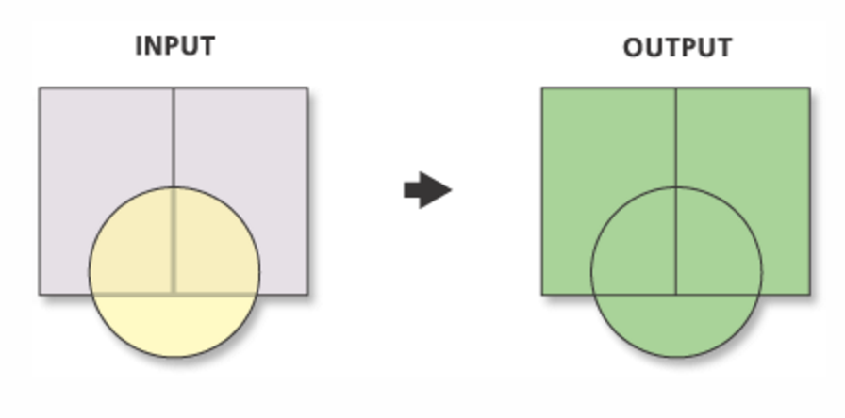
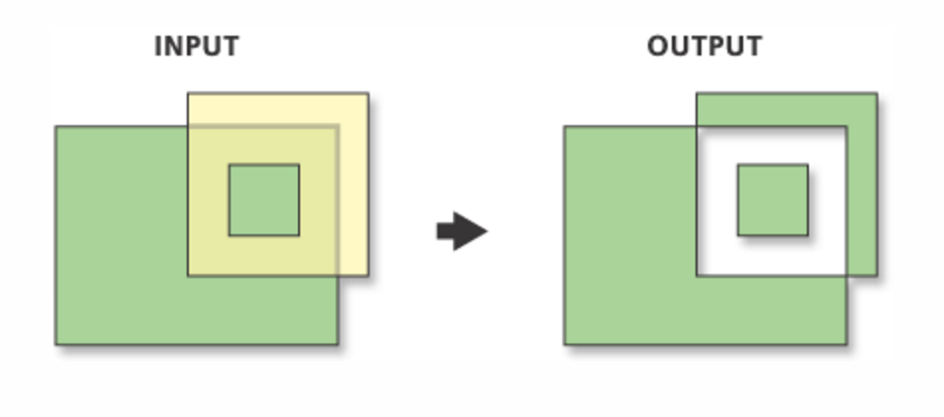
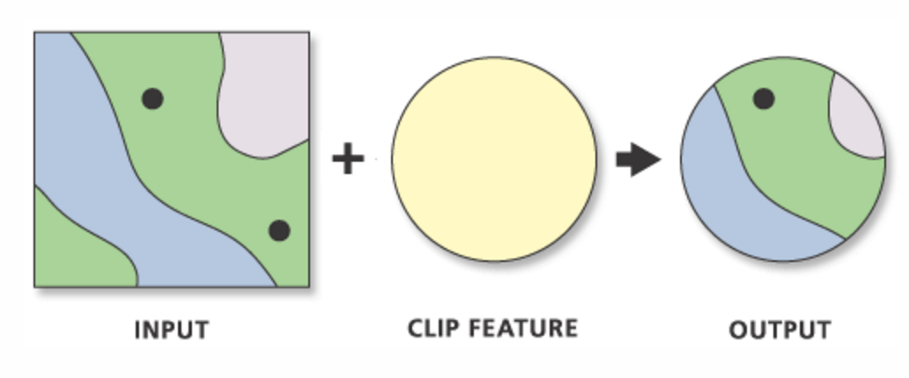
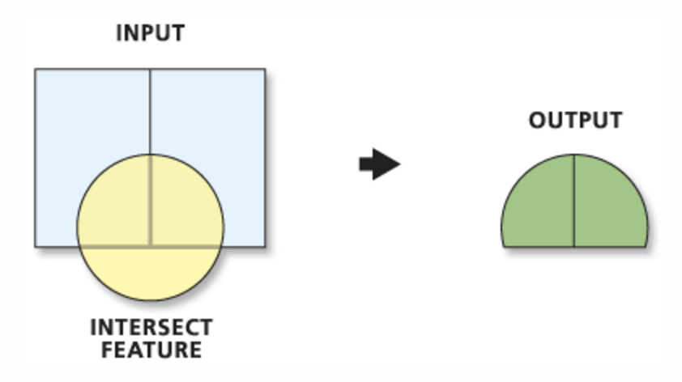
Operations: Overlay
Union
Symmetric Difference
Clip
Intersection
Notes:
[Kristian]
Understanding the relationships between geometries is useful, but very often in applications you need the actual intersection geometry between shapes, or you need to clip shapes, union shapes. These are typically used for overlay operations.
The geometry Engine allows you to do this kind of operation as well.

Slide 6
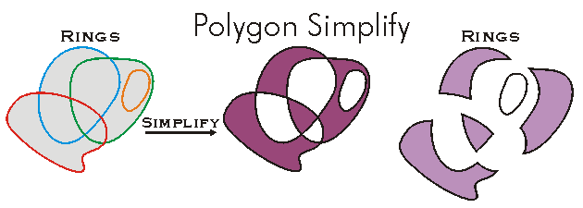
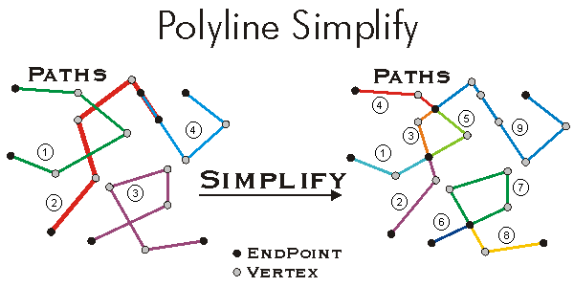
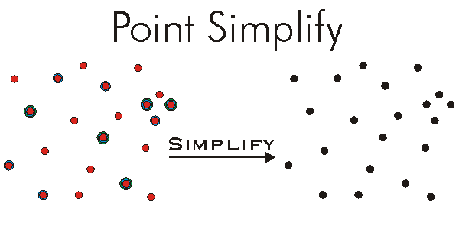
Operations: Topological correctness
Simplify
isSimple
Notes:
[Kristian]

Slide 7
Operations: Nearest vertices/coordinates
Notes:
[Kristian]

Slide 8
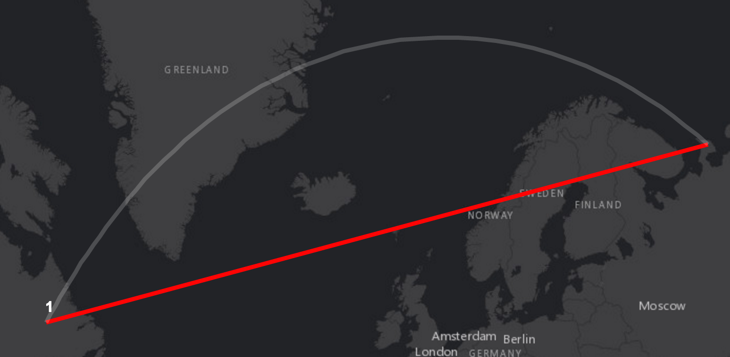
Operations: Measurement
geodesicLength
planarLength
geodesicArea
planarArea
Notes:
[Kristian]
There are also other kinds of operations… distances and measurements.. What is the distance between two points, or the length or area of a line.
The geometry Engine gives you the ability to calculate planar lengths and areas for features.
Also importantly, it gives you the ability to do geodesicLengths and geodesic areas. [If you are in WebMercator].. It is worth pointing out, that the geometry engine does not have projection engine. If you need to do projection you will need to use server side calls.

Slide 9
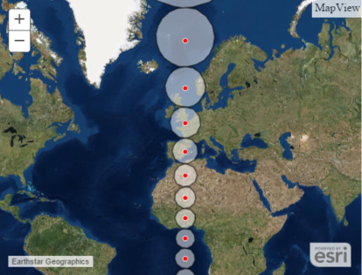
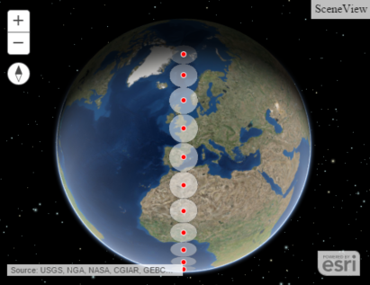
Operations: Buffering
Planar and Geodesic Buffering
Notes:
[Kristian]

Slide 10
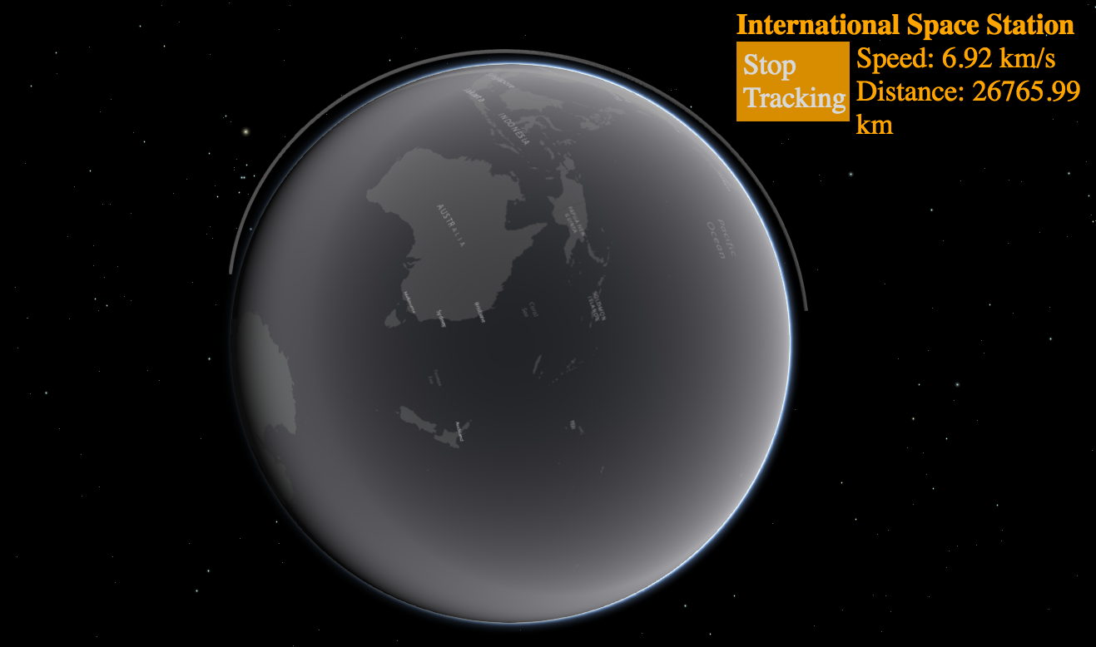
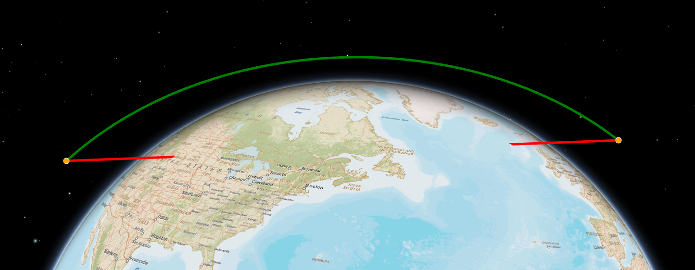
Other Operations
Rotate
Flip
Generalize
Densify
ConvexHull
geodesicDensify
Notes:
[Kristian]
There are many more methods in the geometry engine…
Buffering, and Geodesic Buffering allows you to grow and shrink geometries.
Generalize and Densify, allow you increase or reduce the number of vertices in your geometries.
IsSimple and Simplify allow you to fix issues with your geometry, and make them legal. This allows you to fix geometry that is not topologically correct, say if it has self intersecting lines

Slide 11
I can do this already…
It’s called the Geometry Service!
Notes:
[David]
You will all have realised, that you have been able to do all of these operations for the past 10 years with the ESRI Javascript API.
You can just make a REST call to the Geometry Service, and …. You have clipped, unioned, intersected
What has been different about these demos, is the user interacton, the user experience

Slide 12
User Experience: Interactivity
Geometry Service REST Call
Encoding
Geometry
as JSON
5ms
Sending Request over Network
200+ ms
Running Geometry
Operation
100+ ms
Sending Response back
over Network
200+ ms
Decoding
Response
5ms
Notes:
[David]
When you use the Geometry Service, requires you to make a REST Call
The geometry involved in the operation is converted to JSON, sent over the wire to the Geometry Service. The geometry service runs its logic, and sends the results back over the wire.
This is 500ms + for every operation… For poor networks, or large payloads even longer.
Interactive UX is measured in <300ms

Slide 13
User Experience: Interactivity
Geometry Engine API Call
Running Geometry Operation
200+ ms
Notes:
[David]
Compare that to the Geometry Engine.. The code is all just running client side.

Slide 14
Demo
How many REST calls can I save?
Notes:
[David]
Demo : Apple Orchard showing what would have been Network Requests. That kind of interactivity not possible with Geometry Service

Slide 15
Writing Apps with Geometry Engine
Notes:
[David]
Change tack, and cover how you would code with and use the Geometry Engine

Slide 16
Geometry Engine : Writing Code
Calling the methods
require( [ “esri/geometry/geometryEngine” ],
function( geometryEngine ) {
var buffer = geometryEngine.buffer(mapPoint, 10, “miles”);
});
Notes:
[David]
First of all Geometry Engine is just a Module.
You AMD load it in like any of the other JS API module. For both 3.x and 4.x
When you look at the module, it has very simple method. For example as in this case. To do a Buffer you just call the Buffer Command.
When we looking at the interface, we looked at the other APIS and SDKs and tried to get a very similar set of names and calling conventions.
Call the Operation

Slide 17
Geometry Service : Code Comparison
require( [ “esri/tasks/GeometryService”, “esri/tasks/BufferParameters” ],
function( GeometryService, BufferParameters ) {
var geomService = new GeometryService("//.../GeometryServer");
var bufferParams = new BufferParameters();
bufferParams.geometries = [mapPoint]
bufferParams.distances = [10]
bufferParams.unit = GeometryService.UNIT_MILE;
bufferParams.outSpatialReference = map.spatialReference;
geomService.buffer( bufferParams, function(buffer) {
});
});
Notes:
[David]
One of the benefits of the Geometry Engine is it simplifies your code.
Its important to say that the geometry engine is a lot of code, however it is simplifying the amount of code you have to write.
You can see the comparison of the geometry engine versus using the geometry service. As you can see there are a lot more lines of code. Now there are more options with the online service, but it is a much more complex operation to call.
There is a lot more code running in your browser… The geometry service has more operations

Slide 18
Building Editing Apps
Notes:
[David]
Most common thing to do with JS API, is to build an Editing App
I am going to create a new feature. Then I am going to Append, Subtract, Split, Merge… No lag time
I am going to show the code…
I can also do effects… Spinning, Buffer, and Negative Buffers
Simple Interactions, all happening quickly…
Here I am digitizing with an Offset, but also getting distance.
Look at Operation Code…

Slide 19
Building Analysis Apps
Notes:
[Kristian]

Slide 20
Synchronous versus Asynchronous
You can use Geometry Engine Async
Notes:
[David]
So far we have been concentrating on the synchronous
. There is actually though the asynchronous version as well.

Slide 21
Geometry Engine Async
Asynchronous Geometry Engine
Uses Web Workers to perform Geometry Engine
Operations return Promises.
Benefits
Browser is not blocked whilst operations run
Greater throughput. Operations can run in parallel
Easier substitution of existing GeometryService code
Drawbacks
Older Browsers do not support WebWorkers
Notes:
[David[
The async version uses Web Workers.
The reason there is two, is because when you use the synchronous one, your UI thread is blocked.
That is fine for a lot of use cases, but for some use
For that reason we have provided the Aysync
With the Async, you call the GE operation, and it is passed to the web worker. You get a promise, and when the operation is finished, your promise gets resolved.
The browser isn’t blocked
Makes it easier to substitute Geometry Service
You can great throughput, more operations in parallerl, and makes it easy to substiture existing geometry service code,
The downside is that not all browsers support WebWorkers (although most do now).

Slide 22
Asynchronous Patterns
Uses Deferred Pattern
require( [ “esri/geometry/geometryEngineAsync” ],
function( geometryEngineAsync ) {
geometryEngineAsync.buffer(mapPoint, 10, “miles”).then( function(buffer) {
},
function(err) {
});
});
Notes:
[David]
How you use the async version is nearly identical
Its literally nearly identical code.
AMD the Module,
Call the Operation
The only difference is that you get the promise, and have to wait for it to be resolved.
Quickly give you a demo of using the Async Operation.
DEMO Geometry Buffering
This sample buffers 500 world cities. One with the GE engine, one with the Service.
Already the Async service is finished.. All 500, in 2 seconds.
28 seconds later…
You can really see the performance you get of using the client side, versus going over the wire

Slide 23
Geometry Engine internals
What is the Geometry Engine doing for me!
Notes:
[DAVID]
Now going to go into a bit more detail about what is going on in the geometry engine.
Perhaps answer the question.. What is the geometry engine doing for me.

Slide 24
Spatial Tolerance
Spatial References have different Tolerances.
GeometryEngine uses X/Y Tolerance
in its calculations
XY Tolerance = 0.001
Notes:
[David]
Perhaps one of the most difficult to think understand, is that the geometry engine is working with a spatial tolerance.
Coordinate systems have tolerance, an X/Y distance where it doesn’t make sense for two points to be considered different.
This is shown in this slide above, with the ends of the two segments. The geometry engine will consider the two end points to be the same point, because they are within a x/y tolerance of each other. They are so close together they are the same point.
This is all built into the coordinate system, it is the x/y tolerance of the coordinate system. This has big implications for the geometry engine, and is built in, and is one of its big benefits.
It is used in nearly all the methods, points are clustered together when they are very close to each, lines are cracked when a point is effectively on the line, ie. a Point is introduced.

Slide 25
Spatial Tolerance
Inside the Geometry Methods
require( [ “esri/geometry/geometryEngine” ],
function( geometryEngine ) {
var mapPointA = new esriPoint(1.22, 2.0, map.spatialReference)
var mapPointB = new esriPoint(1.22000000001, 2.0, map.spatialReference)
var areequal = geometryEngine.equals(mapPointA, mapPointB);
// Returns True
});
Notes:
[David]
It has some strange effects, that can be considered beneficial.
This is consistent across the platform, in all calls to the geometry engine. They all use tolerance, and automatically cluster points.
If you look at this sample above, the two points are infintissimally different. But any call to the geometry engine will treat them as equals

Slide 26

Geometry Engine Async
Architecture and Throughput
buffer
Queued Geometry Operations
Busy
Busy
Busy
Busy
Free
Deferred
Resovled
WebWorker
SendMessage
Web
Worker
Web
Worker
Web
Worker
Web
Worker
Web
Worker
geometryEngine
Async
Notes:
[David]
If we look at another area of the Geometry Engine
We can look at how the web worker, or async geometry engine is working.
There is a concern that I can flood the async engine, if I create 1000 operations can I flood the engine, or will I create 1000 web workers.
That is not how it works.. There is a queue. Every time you call an operation it is added to the queue. That queue is serviced by a number of web workers. Somewhere between 4-8.. You will never swamp your browser, but you are getting the maximum throughput that you can.
Web workers pick items of a queue and call sendMessage to indicate the result.

Slide 27
Coordinate Systems
Projected and Geographic
No Project Operation
Certain methods will only work in WebMercator or Geographic Coordinate Systems
GeodesicArea
GeodesicLength
GeodesicBuffer
Notes:
[David]
So also talking about coordinate systems
One limitation of the geometry engine, is that there is no projection engine
There is no project method.
Certain methods will not work, such as geodesic area, length or buffer) unless you are working in WebMercator (which is projected but we have a special routine for converting it to a geographic coordinate system), or a Geopraphic coordinate system.
So this is something to be aware of when you are using a projected coordinat system. However usually when you are using a projected coordinate system, the accuracy of the planar methods are quite good, because this is the purpose of the projected coordinate system is that it is accurate for the area you are working in.

Slide 28
When to use the Geometry Engine
When will it make a difference in my app
Notes:
[David]
Another question that arises, is when should you use the geometry engine,
And the answer is not awlays, there are some very definite cases when you should and should not use the geometry engine

Slide 29
Geometry Engine: Trade-offs
Trade-off between Geometry Service and Geometry Engine
Large AMD download for Geometry Engine
versus
Network latency and round trip cost of Geometry Service
Other Considerations: Apps Requirements
Unsupported operations : projections
Frequency of calls : user interactivity
Offline or poor network connection
Ease of coding
Notes:
[David]
Its all about trade offs.
The GE engine is quite a big module of code.
So the first tradeoff you should consider is how long will it take to download and load the module of code into your application. Versus repeated calls to the geometry service.
If your application is only going to make one call to the Geometry Service, it is probably not worth loading the geometry engine.
Other requirements,
How often are you going to be calling geometry methods. If it is a lot it maybe worth using the Geometry engine.
If your network is going to be poor or occasionally connected
Another reason is ease of coding, it is very simple api to use, its got simple method signatures
It is got to be on an app by app basis
The same is true for async versus sync calling of the geometry engine
The async call is harder programming, but has the advantage that it doesn’t block your uithread
Many reasons you don’t need async.
You may be calling nearest coordinate or similar methods, which are going to be very quick to call and return

Slide 30
GeometryEngine Resources
Documentation, Blogs, Samples
Notes:
[Kristian]

Slide 31
Resources
Documentation
https://developers.arcgis.com/javascript/latest/api-reference/esri-geometry-geometryEngine.html
https://developers.arcgis.com/javascript/latest/api-reference/esri-geometry-geometryEngineAsync.html
Blogs
Testing spatial relationships and editing
Measurement
Overlay analysis
Demos/samples
https://github.com/ekenes/conferences/tree/master/ds-2017/geometry-engine
https://github.com/ekenes/esri-js-samples

Slide 32
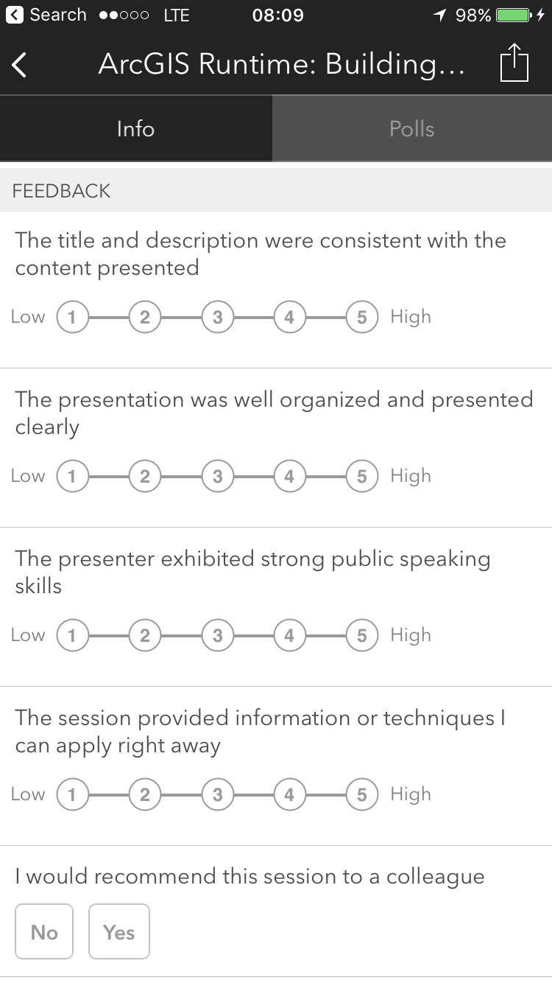
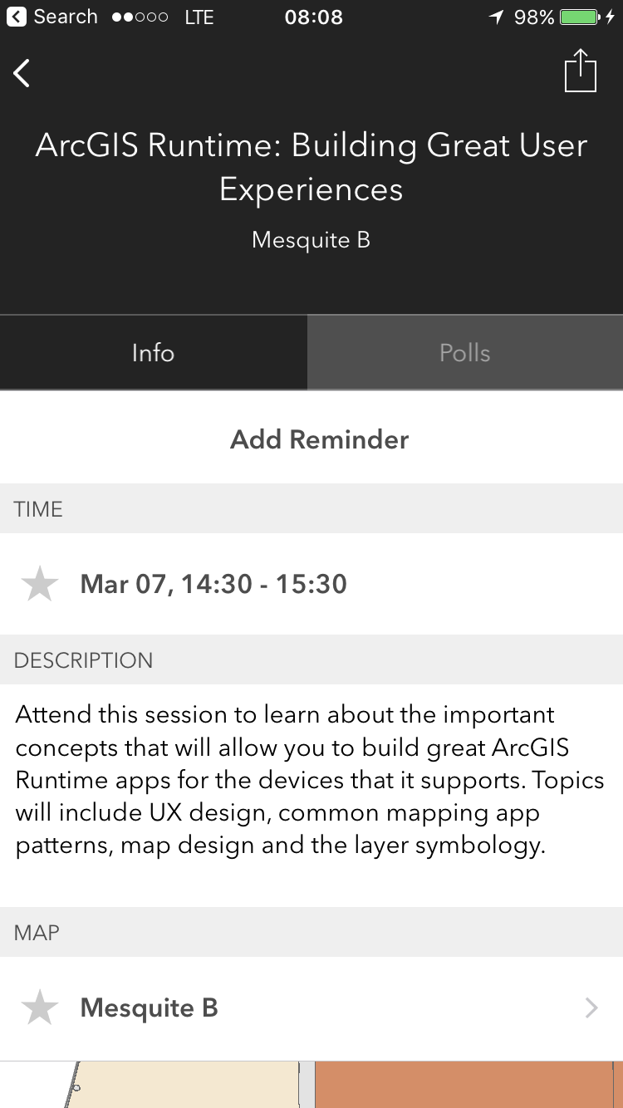

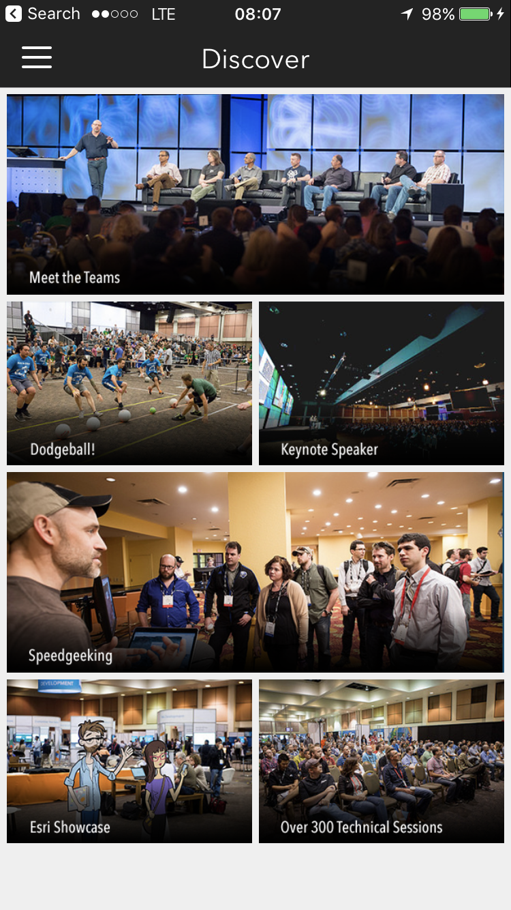
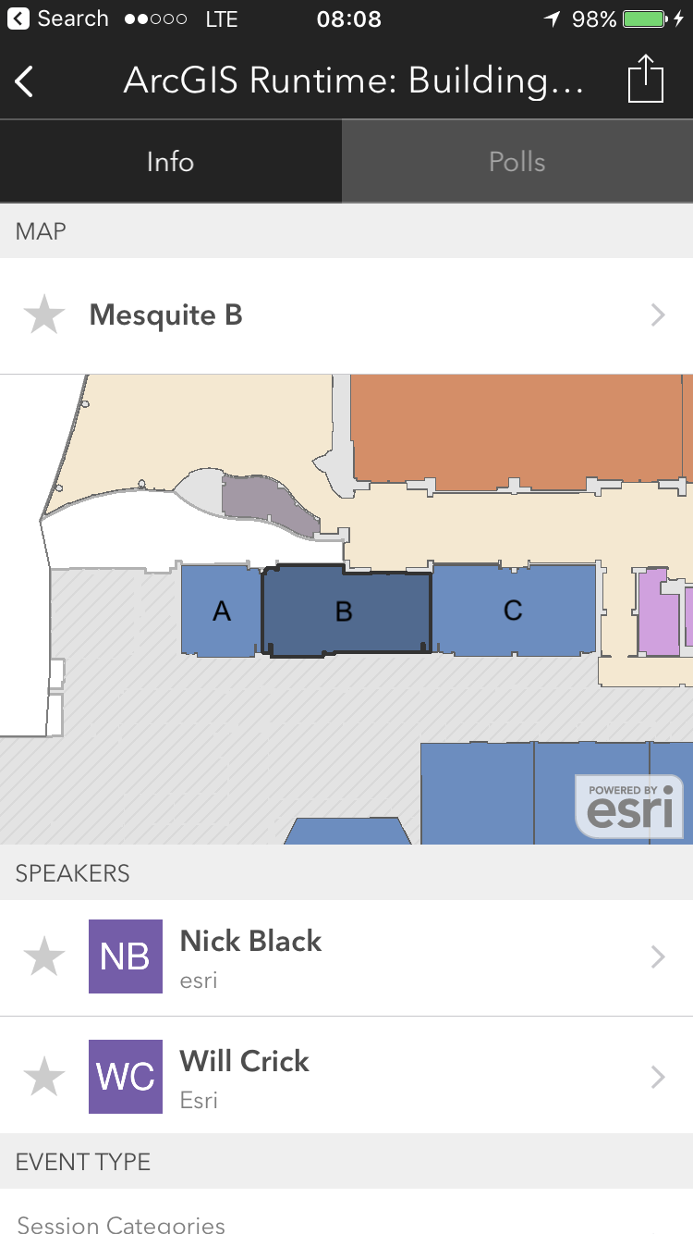
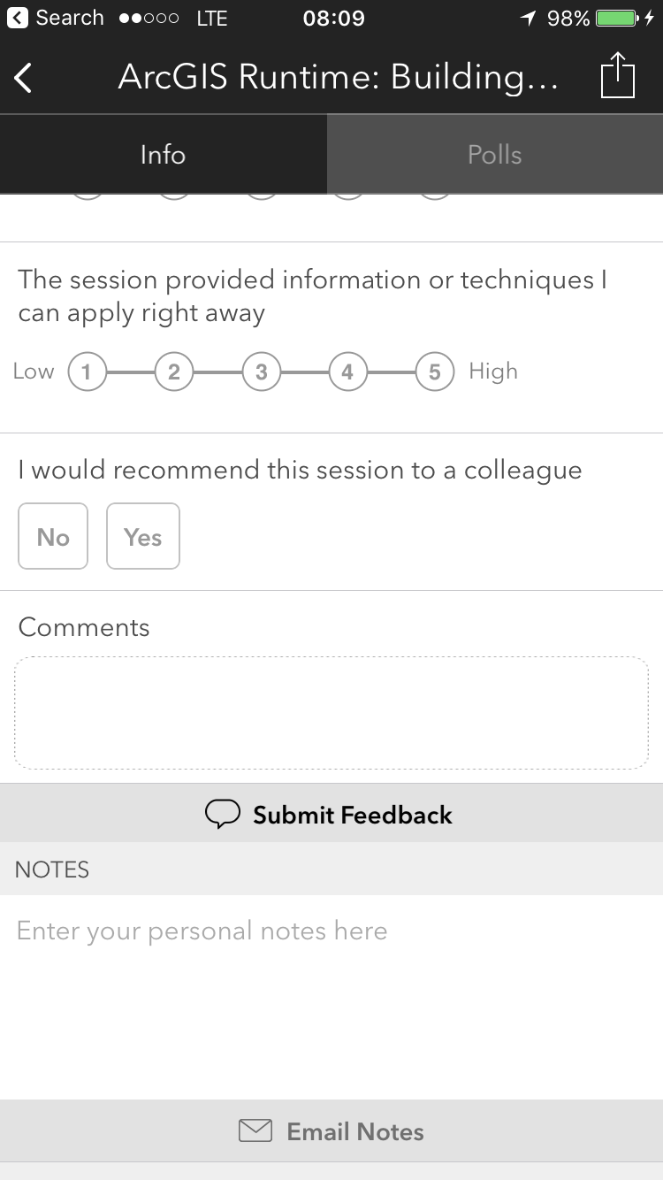
Please Take Our Survey!
Scroll down to the
“Feedback” section
Download the Esri Events app
and go to DevSummit
Select the session you attended
Complete Answers,
add a Comment,
and Select “Submit”

Slide 33



